Slide 1
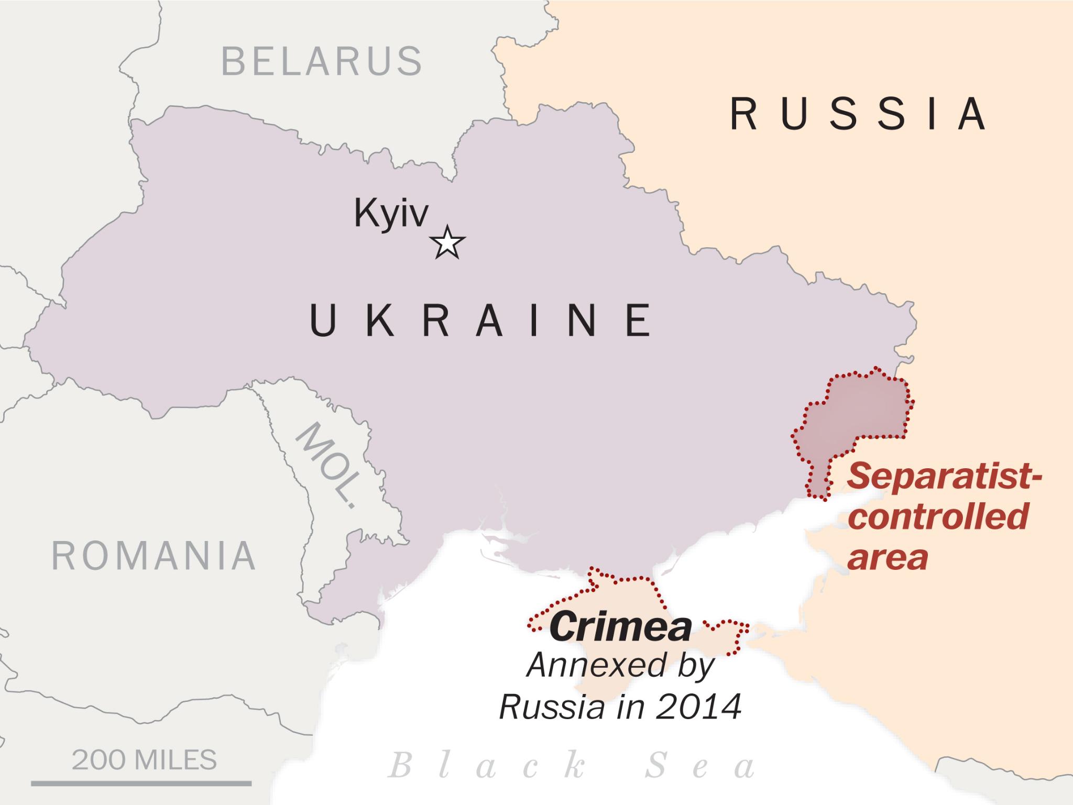
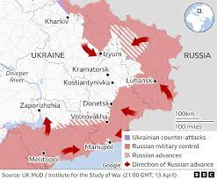
The Ukraine is located east of the continent of Europe. To the east is Russia, north is Belarus and the west is Poland, Hungary and Slovenia.
Russia - Ukraine conflict Knowledge Organiser
Conflict continued…
18 million people have been affected by the Russian invasion 1.2 million people have been forced to leave the Ukraine and go to another country as refugees 160,000 are currently homeless in the Ukraine 2.9 million people have needed humanitarian assistance – have needed food, medical care or water
The history of the Russo - Ukrainian conflict
1) Between 882 and 1132, the area we know as the Ukraine was part of the Kievan Rus. | 2) Between 1648 and 1686 there was a devastating war known as to people of the Ukraine as ‘The Ruin’.
3) Russia controlled the Ukraine from 1686 to 1917. Ukraine was named as South Russia and Little Russia. | 4) In 1917 the people of Russia rose up against their rulers. All the countries previously controlled by the Russian Empire, were given ‘independence’.
5) On 22nd January 1919, Ukraine united into one country for the first time. Some Ukrainians wanted independence from the USSR, others wanted to join the USSR. | 6) On 16th July 1990 a new Ukrainian government declared that Ukrainian laws were more important than Soviet Laws. on the 26th December 1991 the Ukraine became independent.
7) Between 1991 and 2014, Ukraine had independence but the government was pro-Russia. This changed in 2014 when a pro-EU government was elected. | 8) In 2014, the Ukrainian government started the process of joining the EU. The Ukrainian President, Poroshenko set the start of 2020 for joining the EU.
A humanitarian crisis is an event or events that threaten the health, safety or wellbeing of a large group of people. Humanitarian crises can be caused by war, natural disasters, famine, and outbreak of disease.

