Slide 1
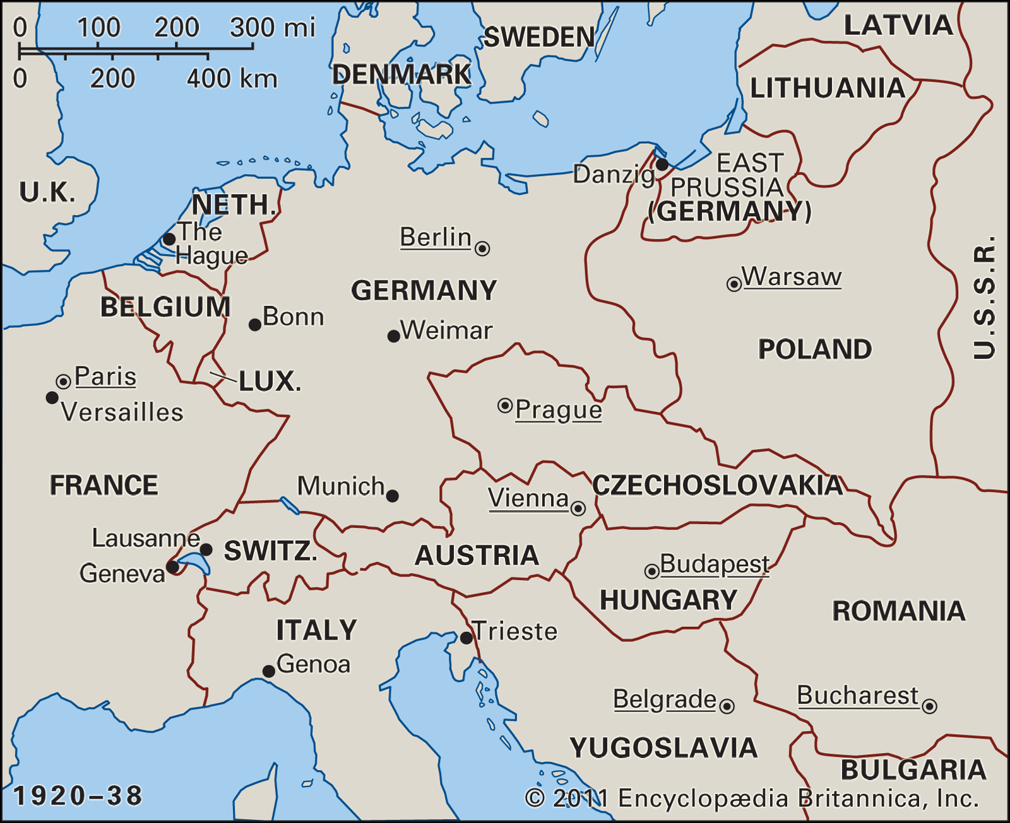
Inter-War Period
Important Terms | Important words
1 | Treaty of Versailles | The Treaty of Versailles ends World War One and imposes heavy reparations payments on Germany.
2 | Kellogg-Briand Pact | Stated that the singing parties condemned recourse to war,
3 | League of Nations | It was established as the body of international cooperation after World War One.
4 | Locarno Pacts | They were a series of treaties signed to assure the stability of Germany's borders and discourage Germany from lashing out at its neighbors.
5 | Political Party | A political party is an organisation that coordinates candidates to compete in a particular country's elections.
6 | Foreign Policy | A government's policy on dealing with other countries.
7 | Manifesto | A public declaration of policy and aims
Important people/groups | Important people
1 | David Lloyd George | British Prime Minister for the Liberal Party.
2 | Paul Von Hindenburg | President of Germany.
3 | Benito Mussolini | The Premier of Italy.
4 | Josef Stalin | Leader of the Soviet Government.
5 | The Labour Party
6 | The Conservative Party
7 | The Liberal Party
Key Events
14 December 1918- David Lloyd George's coalition wins the post-war election | June 28, 1919: The Treaty Of Versailles Is Signed- The Treaty of Versailles ends World War One and imposes heavy reparations payments on Germany. | November 1920: The First Meeting Of The League Of Nations The Assembly of the League of Nations meets for the first time in Geneva, Switzerland. | July 1921 Unemployment reaches a post-war high of 2.5 million | 7 May 1928 All women over the age of 21 get the vote | 24 October 1929 Wall Street Crash sparks the Great Depression | 3 September 1939 Britain declares war on Germany in response to the invasion of Poland

